Slide 1
IR-Winter-2019
Mansi A. Radke, CSE, VNIT

Slide 2
Introduction of Mansi A. Radke
B.E. (CSE), Cummins college of Engineering for Women, Pune, India - 2004
M.S. (CS), University of Maryland, Baltimore County (UMBC), USA – 2008
Ph.D. (CSE), Visvesvarya National Institute of Technology, Nagpur, India – 2018
13+ years of experience together in industry and academics
5+ years of Industry Experience:
Cummins India limited, Pune, India (2004-2006)
SAP Washington, DC, USA (2007-2008)
Persistent systems, Nagpur, India (2009-2011)
8+ years of Teaching experience:
UMBC, Maryland, USA – Teaching Assistant (2006-2008)
Huston-Tillotson University, Austin, USA (2009)
Ramdeobaba College of Engineering, Nagpur, India (2011-2012)
Visvesvaraya National Institute of Technology, Nagpur, India (2012- till date)

Slide 3
Research Interests
Research Interests over the years
Information retrieval
Geographical Information Retrieval
Natural Language Processing
Applications of Machine learning to NLP And IR problems

Slide 4
Books for Information Retrieval
Text Book:
Christopher, D. Manning, Raghavan Prabhakar, and Schutz Hinrich. “An Introduction to information retrieval." An Introduction To Information Retrieval. Cambridge University Press, 2008.
Reference Book:
Büttcher, Stefan, Charles LA Clarke, and Gordon V. Cormack. Information retrieval: Implementing and evaluating search engines. Mit Press, 2010.

Slide 5
Course Outline – Till sessional I
Introduction to basics of Information retrieval
Boolean Retrieval
Posting Lists Algorithms
Inverted Indices as an ADT
Phrase Search Algorithms
Tolerant Retrieval
Edit distance algorithm
String matching algorithms
Vector space model
Various variants of vector space model
Evaluation in Information retrieval

Slide 6
Course Outline – Till Sessional II
Index construction
Index compression
Relevance feedback
Probabilistic IR
Language models for IR
Latent Semantic Indexing
Web Search
Page rank algorithms
HITS algorithms

Slide 7
Course Outline – till End Sem
Text Classification using Naïve Bayes
Clustering techniques
K means algorithm
Flat and hierarchical clustering
Purity of clustering
Advanced topics in IR
Evaluation in IR more details
Fairness issues in IR
Parallel IR
Research directions in IR
Introduction to Geographical Information Retrieval

Slide 8
Grading Criteria
15 marks Sessional I
15 marks Sessional II
50 marks End Semester
20 marks Programming assignments

Slide 9
Lecture 1 Basics of Information Retrieval
- Mansi A. Radke
Ph.D. (Computer Science)
Assistant Professor
Computer Science and Engineering
VNIT, Nagpur.

Slide 10
What is Information Retrieval?
Information Retrieval is the activity of -
obtaining information resources
relevant to an information need
from a collection of information resources.
The system doing this task is termed as a search engine!
Examples: Google, Bing, Yahoo
Note: The collection on which these search engines work is the world wide web.

Slide 11


Components of an IR System
Information
Need
Result
Query
Search Engine
deletions
Additions
Index

Slide 12
Steps In Information Retrieval
Crawling
Pre-processing
Tagging (optional)
Indexing
Relevance Ranking
Display of results to user

Slide 13
What is a corpus?
Data store / collection of documents on which search is performed
E.g. Reuters corpus, world wide web, news articles corpus etc.

Slide 14
Difference between structured and unstructured data
Structured
Data searchable by basic algorithms (The data has a structure associated with it)
Relational Database
Spread sheets etc.
Unstructured
Not searchable by basic search algorithms (The data does not have a specific structure associated with it)
Natural language text
Information Retrieval
Handles both structured and unstructured data

Slide 15
What is the difference between Information Retrieval and Data Mining?
IR retrieves the data in the same format as it is present in the data store
Example: A pdf will be returned as a pdf and doc file as it is
In data mining the data is analysed to find hidden patterns in the data
Example: A supermarket sales data could indicate that whoever buys eggs buys bread too. So they can keep bread and eggs in the same aisle.
It finds this out buy data mining and pattern matching algorithms

Slide 16
What is the difference between an information need and a query?
Information need is the need of the user or requirement of the user
Query is the representation of the information need such that computer will understand it
An IR systems performance is evaluated with reference to an information need and not with respect to the formulated query!

Slide 17
The notion of ‘Relevance’
Relevance denotes how well a retrieved document or set of documents meets the information need of the user

Slide 18
How is an IR system Evaluated?
Precision
What fraction of the returned results are relevant to the information need?
Recall
What fraction of the relevant documents in the collection were returned by the system?
F1 measure
Weighted harmonic mean of precision and recall.
Precision or recall alone is not sufficient to analyse the performance of an IR system.

Slide 19
Examples
Suppose a computer program for recognizing dogs in photographs identifies 8 dogs in a picture containing 12 dogs and some cats. Of the 8 identified as dogs, 5 actually are dogs, while the rest are cats.
The program's precision is 5/8
while its recall is 5/12.
When a search engine returns 30 pages only 20 of which were relevant while failing to return 40 additional relevant pages.
Its precision is 20/30 = 2/3
while its recall is 20/60 = 1/3.
Precision is "how useful the search results are", and recall is "how complete the results are".

Slide 20
Indexing and Inverted Indices
Inverted Indices for inverted files – Data structure
Consider the following
Doc 1: I am Mansi
Doc 2: I live in Nagpur
Doc 3: I am a teacher
Dictionary for this corpus will consist of the following words:
I, am, Mansi, live, in, Nagpur, am, a, teacher
Inverted Index for this corpus will look like
I
am
Mansi
live
in
Nagpur
a
teacher
doc1
doc2
doc3
doc1
doc3
doc1
doc1
doc1
doc1
doc1
doc1

Slide 21
Inverted Index of a corpus
Term Vocabulary / Lexicon/ Dictionary
+ =
Posting list for each term
Inverted Index for the corpus
(Note: Indexing is a one time activity)

Slide 22
Draw the inverted index for the following document collection.
Doc 1: new home sales top forecasts
Doc 2: home sales rise in July
Doc 3: increase in home sales in July
Doc 4: July new home sales rise

Slide 23
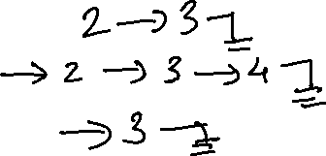
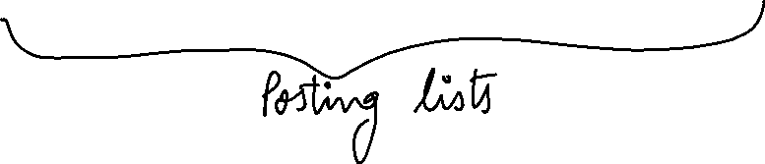

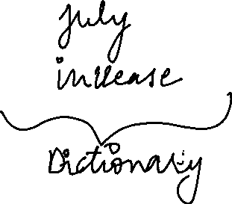
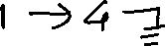






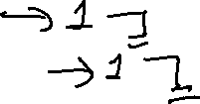

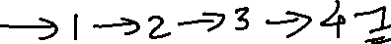

Slide 24
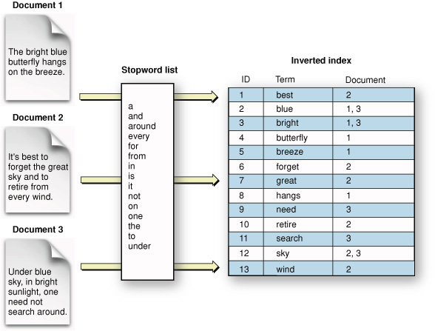
The inverted Index – another example

Slide 25
Term Document Incidence Matrix
Consider the following corpus consisting of 3 documents
Doc 1: I am Mansi
Doc 2: I live in Nagpur
Doc 3: I am a teacher
Dictionary/Vocabulary/Lexicon for this corpus will consist of the following words:
I, am, Mansi, live, in, Nagpur, a, teacher
The term document Incidence matrix for this corpus will look like:
 | Doc1 | Doc2 | Doc3
I | 1 | 1 | 1
am | 1 | 0 | 1
Mansi | 1 | 0 | 0
live | 0 | 1 | 0
in | 0 | 1 | 0
Nagpur | 0 | 1 | 0
a | 0 | 0 | 1
teacher | 0 | 0 | 1

Slide 26
Draw the term document incidence matrix for the following document collection
Doc 1: Breakthrough drug for schizophrenia
Doc 2: New schizophrenia drug
Doc 3: New approach for treatment of schizophrenia
Doc 4: New hopes for schizophrenia patients

Slide 27

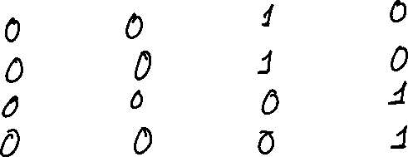
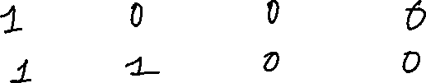
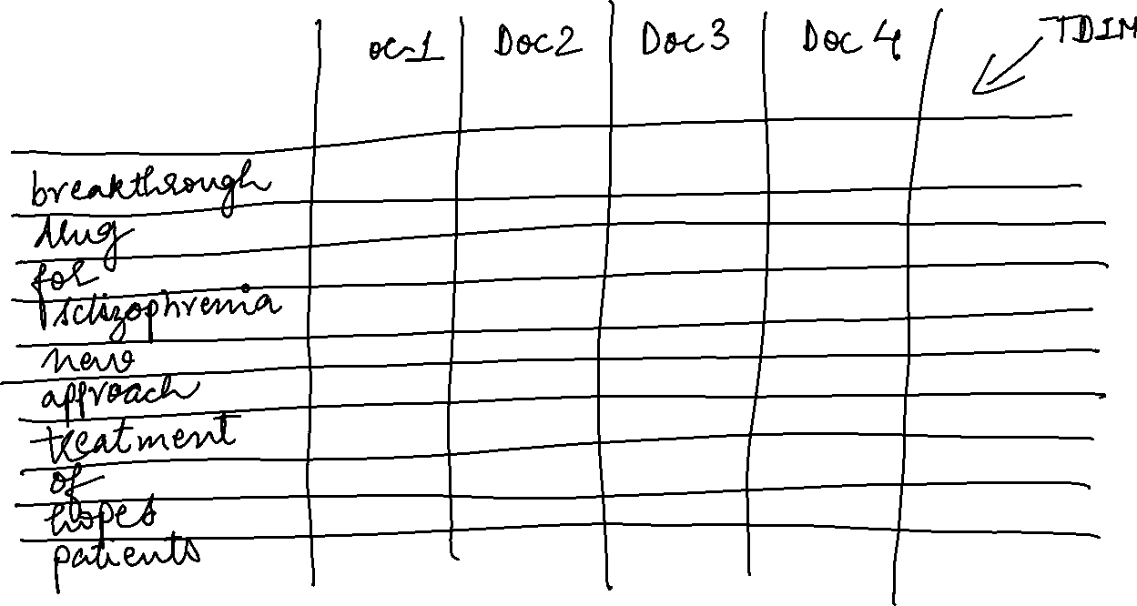

Slide 28
For the same document collection what will be the returned results for the following:
schizophrenia AND drug
Vector for ‘schizophrenia’ 1 1 1 1
Vector for ‘drug’ 1 1 0 0
for AND NOT (drug OR approach)
Vector for ‘for’ 1 0 1 1
Vector for ‘drug’ 1 1 0 0
Vector for approach 0 0 1 0

Slide 29
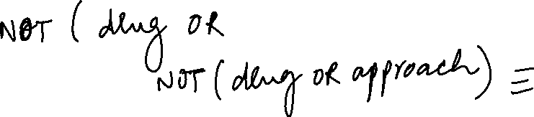
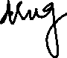

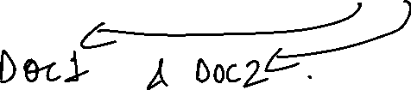
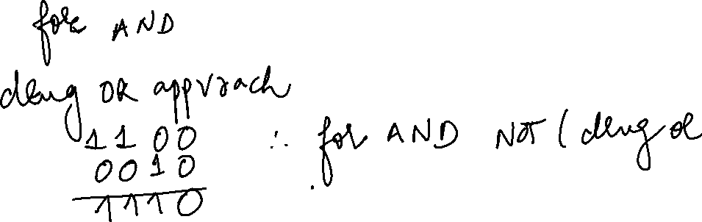


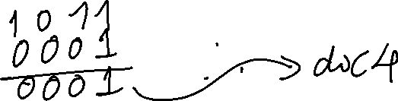
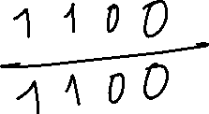
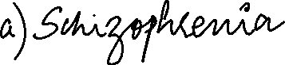



Slide 30
Term Frequency of a term in a document
Consider the following document:
The geography of a blog can be indicated in terms of its source geography and target geography. The source geography of the blog includes the physical location of the server on which the blog is located or the physical location of the author or owner of the blog. The target geography includes the contents of the blog or the subject about which the posts in the blog express opinion about. Generally people consider the target geography of a blog.
The term frequency of the word “geography” in this document is:
6
The term frequency of the word “blog” in this document is:
7

Slide 31
Document frequency of a term in a corpus
Consider a document containing 100 words wherein the word cat appears 3 times. The term frequency for cat is then 3. Now, assume that we have 10 million documents and the word cat appears in one thousand of these. Then the document frequency of the term cat in the corpus in 1000
Definition: Number of documents in the corpus which contain the particular term.

Slide 32
Stop Words in English and the concept of Stop List
["i", "me", "my", "myself", "we", "our", "ours", "ourselves", "you", "your", "yours", "yourself", "yourselves", "he", "him", "his", "himself", "she", "her", "hers", "herself", "it", "its", "itself", "they", "them", "their", "theirs", "themselves", "what", "which", "who", "whom", "this", "that", "these", "those", "am", "is", "are", "was", "were", "be", "been", "being", "have", "has", "had", "having", "do", "does", "did", "doing", "a", "an", "the", "and", "but", "if", "or", "because", "as", "until", "while", "of", "at", "by", "for", "with", "about", "against", "between", "into", "through", "during", "before", "after", "above", "below", "to", "from", "up", "down", "in", "out", "on", "off", "over", "under", "again", "further", "then", "once", "here", "there", "when", "where", "why", "how", "all", "any", "both", "each", "few", "more", "most", "other", "some", "such", "no", "nor", "not", "only", "own", "same", "so", "than", "too", "very", "s", "t", "can", "will", "just", "don", "should", "now"]
In computer search engines, a stop word is a commonly used word (such as "the") that a search engine has been programmed to ignore, both when indexing entries for searching and when retrieving them as the result of a search query.
The list of words that are not to be added is called a stop list.

Slide 33
Tf-idf model
Term frequency (tf)
Document frequency (Dft)
Inverse document frequency (idf)
Total number of terms in the corpus (N)
Inverse Document frequency (idf) for a term is given is given by log (N/Dft)
Tf-idf model weighs each term by its tf-idf value
Tf-idf value of a term is its term frequency multiplied by inverse document frequency
Tf-idf (of a term t) = tf * log (N/Dft)
How stop words get handled in this model ?
e.g. The brown crow

Slide 34
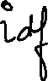

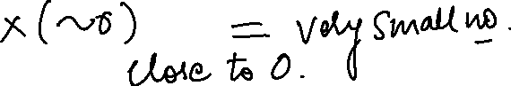

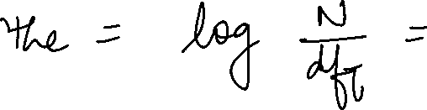
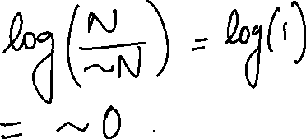



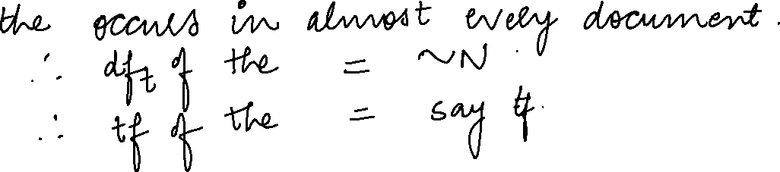



Slide 35
Some points to ponder!
Why is idf of a term always finite?
What is the idf of the term that occurs in every document? Compare this with the use of stop words list.
Can the tf-idf weight of a term in a document exceed 1?
While calculating the tf-idf scores, how does the base of the logarithm affect the scoring of the documents or ranking of the documents for a given query?

Slide 36
Stemming, lemmatization and case folding
Stemming
Chopping off affixes is called stemming
Examples of stemmers: Porter Stemmer, Snowball Stemmer, Lancaster Stemmer
Recommened: Snowball
Examples
Marketing
Market
Successful
success
Case folding
converts everything to lower case and helps match the case differences
Lemmatization:
Lemma – original form of the word
Lemmatization is the process of converting a word to its base form. The difference between stemming and lemmatization is, lemmatization considers the context and converts the word to its meaningful base form, whereas stemming just removes the last few characters, often leading to incorrect meanings and spelling errors.
Examples of lemmatizers: NLTK, TextBlob, spaCy, Pattern and Stanford CoreNLP
Recommended: Spacy
Examples
Saw
See
Is
Be
Was
be

Slide 37
Information Retrieval Models
Boolean Model
Extended Boolean Models
Vector Space Model
Probabilistic Model

Slide 38
The Boolean Model

Slide 39
Boolean retrieval Model
AND , OR, NOT
No ordering of the results
All documents have the same rank with respect to the query
Only way to change output is to reformulate the query

Slide 40

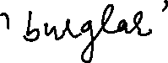
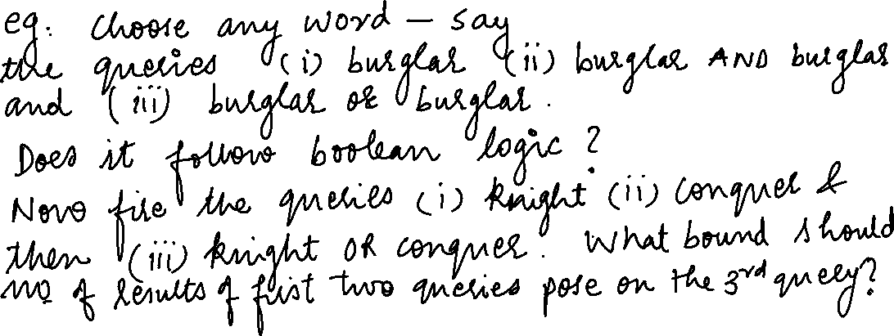

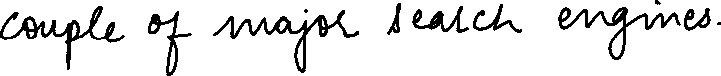


Slide 41
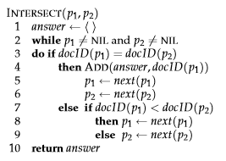
Posting list intersection algorithm(AND query)

Slide 42
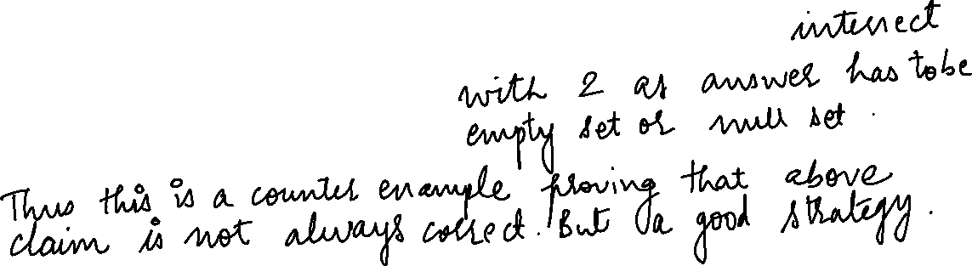

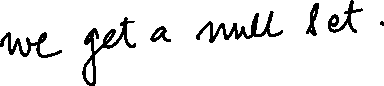
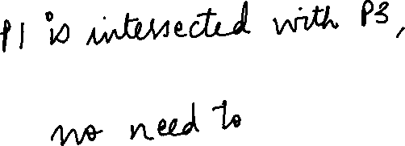
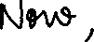
Order of processing
For a conjunctive query, is processing postings lists in order of size guaranteed to be optimal?
Term 1 – 1,2,3
Term2 – 2,3,4,5
Term3 – 10,11,20,30,50

Slide 43
Write the pseudo code for posting list intersection for two posting lists for an OR query…………

Slide 44
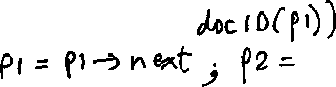


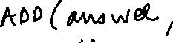

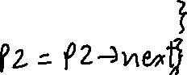

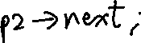
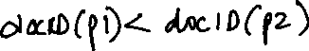


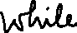
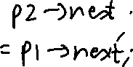
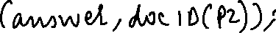
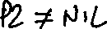
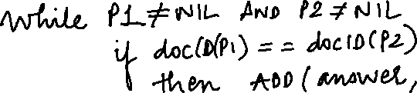

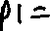
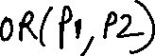
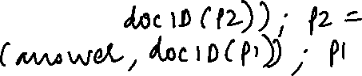

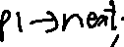
Posting list union algorithm for (OR query)

Slide 45
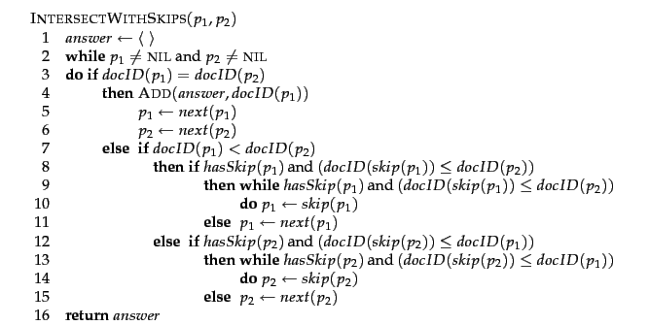
Posting list intersection with skip pointers

Slide 46
Posting list intersection with skip pointers example

Slide 47
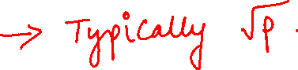
heuristic for placing skips
PL of length p
No of skip pointers ?

Slide 49
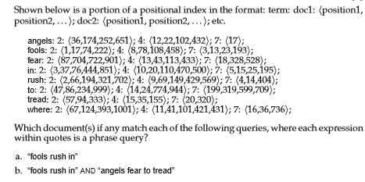

Slide 50
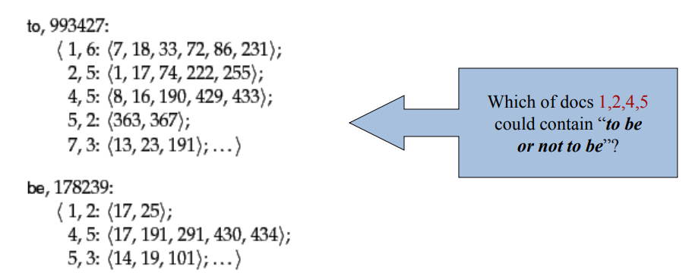
Positional Index

Slide 51
Use of positional index
It is majorly used to handle phrase queries
Consider the following positing lists
Term1: 1:<7,50>
Term2: 1: <17,45>
K = 10
Key idea of the algorithm is it moves the pointers only to the right. Its not brute force.

Slide 52
Proximity Intersection Algorithm/ Positional Intersect Algorithm
An algorithm for proximity intersection of postings lists p1 and p2. The algorithm finds places where the two terms appear within k words of each other and returns a list of triples giving docID and the term position in p1 and p2.

Slide 53
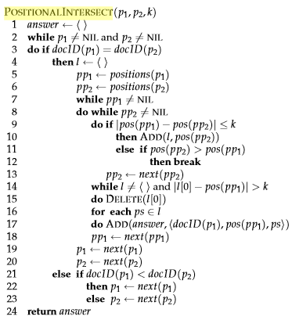

Slide 54
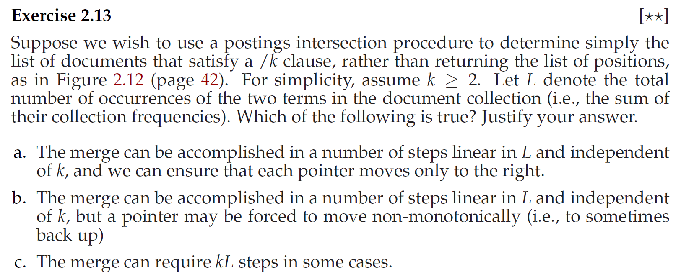

Slide 55
Disadvantages of Boolean Retrieval Model
The Boolean model gives counter intuitive results for certain types of queries
A and B and C and D and E
Low precision
Low recall
Size of the output may be too large or too small
No provision for ranking. All the documents have the same rank
Difficult to control the number of documents retrieved
During the indexing process for the Boolean model, it is necessary to decide whether a particular document is either relevant or nonrelevant with respect to a given index term
The Boolean model has no provision for assigning importance factors or weights to query terms
Difficult to perform relevance feedback

Slide 56

Vector Space Model
Basic Concept:
Every term is a dimension
Query as a vector
Document as a vector
Cosine similarity Measure
Angle between query and document
cos is an monotonically decreasing function
Greater the angle, smaller the cos value and lesser the similarity

Slide 57

Dictionaries and Tolerant retrieval

Slide 58
How does that happen
String matching Algorithms……
Edit Distance is one of those

Slide 59


Edit distance between ‘cats’ and ‘fast’

Slide 60




Slide 61
Minimum edit distance algorithm
Lavenshtein distance – when insert, delete, replace all costs 1 unit
Max(s1,s2) when no common character
Max(s1,s2)
Time complexity ?
O(mXn)
Trace back the answer

Slide 63
Knuth Morris Pratt Algorithm for string matching
Linear algorithm
Complexity O(m+n)
Never backtracks on the input text string T
Makes use of prefix function
The compute prefix function calculates the overlap of pattern string with itself.
The KMP matcher calculates the overlap between the text string and the pattern string.

Slide 66
Runtime Analysis of KMP – Compute prefix function
The running time of COMPUTE-PREFIX-FUNCTION is O(m)
The only tricky part is showing that the while loop of lines 6–7 executes O(m) times altogether
We start by making some observations about k
Observation 1:
line 4 starts k at 0, and the only way that k increases is by the increment operation in line 9, which executes at most once per iteration of the for loop of lines 5–10. Thus, the total increase in k is at most m-1.
Observation 2:
since k < q upon entering the for loop and each iteration of the loop increments q, we always have k < q. Therefore, the assignments in lines 3 and 10 ensure that π(q)< q for all q = 1,2,….m, which means that each iteration of the while loop decreases k.
Observation 3:
k never becomes negative.

Slide 67
Putting these facts together, we see that the total decrease in k from the while loop is bounded from above by the total increase in k over all iterations of the for loop, which is m - 1. Thus, the while loop iterates at most m - 1 times in all, and COMPUTE-PREFIX-FUNCTION runs in time O(m)

Slide 68
Runtime analysis of the KMP matcher routine
Similar argument as we did for the COMPUTE-PREFIX-FUNCTION
Solve the following:
1)
Text T is : abacaabaccabacabaa
Pattern P is : abacab Pi values: 001012
2)
Text T is: bacbabababacaab
Pattern P is: ababaca
Pi values: 0012301

Slide 69
Inverted Index as an ADT
Mansi A. Radke

Slide 71



Slide 72
Traversing the Posting list ADT in general

Slide 78

If all the occurrences of the term are required then we need another loop which calls the nextPhrase function

Slide 79
Another version of nextphrase function which makes calls to next but no calls to previous!

Slide 80
Question to ponder!
When combined with galloping search to find all occurrences of a phrase, would you expect improved efficiency compared to the original version? Explain.

Slide 82
The Vector Space Model

Slide 83
Vector Space Model - Recap
Basic Concept:
Every term is a dimension
Query as a vector
Document as a vector
Cosine similarity Measure
Angle between query and document
cos is an monotonically decreasing function
Greater the angle, smaller the cos value and lesser the similarity

Slide 84
Solve the following question….
Consider a very small collection C that consists of the following 3 documents:
D1: red green rainbow
D2: red green blue
D3: yellow rainbow
For all the documents, calculate the tf scores for all the documents in C. Ignore idf now for simplicity. Assume that the words in the vectors are ordered alphabetically. The normalization by maximum frequency is not needed because the maximum frequency is 1 here.
Given the following query, “blue green rainbow”, calculate the tf vector for the query and cosine similarity score of each document in C with respect to the query. (Do not forget to compute the lengths of the vectors). What is the final order in which the documents are presented as a result to the query?

Slide 85
Answer:
d1 or d2 in any order (Same rank)
d3

Slide 86
Solve the following question……
Consider a very small collection C that consists of the following 4 documents.
D1: cute puppy
D2: big puppy
D3: cute white kitten
D4: white kitten
For all the documents, calculate the tf scores for all the documents in C. Ignore idf now for simplicity. Assume that the words in the vectors are ordered alphabetically. The normalization by maximum frequency is not needed because the maximum frequency is 1 here.
Given the following query, “big white puppy”, calculate the tf vector for the query and cosine similarity score of each document in C with respect to the query. (Do not forget to compute the lengths of the vectors). What is the final order in which the documents are presented as a result to the query?

Slide 87
Answer:
d2
d1 and d4 in any order (same rank)
d3

Slide 93
Solve the following question….
Consider a collection made of 4 documents.
D1: John gives book to Mary
D2: John who reads a book loves Mary
D3: who does John think Mary love?
D4: John thinks a book is a good gift
These documents are preprocessed using a stop list and a stemmer. The resulting index is built to allow vector – based queries. Give a graphical representation of this index.
We now focus on three terms belonging to the dictionary, namely book, love and Mary. Compute the tf-idf based vector representation for the 4 documents in the collection. (These vectors are normalised using the Euclidean normalization).
Consider the query “love Mary”. Give the results of a ranked retrieval for this query. What document is considered most relevant?

Slide 94
Answer:
D3
D2
D1
D4

Slide 95
This is the syllabus till Sessional I
Mansi A. Radke

